Slide 1




Transformer-Based Educational SLM with
Deterministic Mathematical Reasoning
A full-stack, transparent AI architecture combining Transformer Small Language Models with a first-principles C++ deterministic mathematical engine.
Rochan
Ansh
Aryan
ID: 2420030176
ID: 2420090100
ID: 2420090049

Slide 2
Problem Statement
Educational SLM with
Deterministic Mathematical Reasoning
Large and Small Language Models excel at conversational English but frequently output incorrect results for algorithmic math tasks such as arithmetic evaluation, primality testing, factorization, and symbolic manipulation.
The proposed system aims to develop a Transformer-based Small Language Model (SLM) integrated with a Tool Router and a Deterministic Mathematical Runtime. The Tool Router identifies whether a user query requires deterministic computation and selects the appropriate mathematical tool for execution. For direct computational queries, the selected tool is invoked immediately. For complex problems, such as multi-step word problems or algebraic reasoning, the SLM decomposes the problem into smaller computational subtasks, invokes the required mathematical tools sequentially, and integrates their outputs to generate a coherent, step-by-step natural language explanation. This hybrid architecture combines the linguistic capabilities of transformer models with the accuracy and reliability of deterministic algorithms for educational mathematical reasoning.

Slide 3






Primary Objectives
Full C++ AI Stack
Deterministic Math Runtime
Fluent & Explainable AI
Design and implement an educational AI framework from scratch in C++, including tensor operations, automatic differentiation, neural network modules, custom tokenizer, and transformer architecture.
Integrate language generation with exact mathematical execution, enabling the system to converse naturally in English while supplying verifiable, step-by-step explanations.
Build an independent mathematical engine for exact calculations: arithmetic, primality, prime factorization, fractions, percentages, ratios, algebraic simplification, and equation solving.

Slide 4
Literature Survey
Modern SLM & Transformer Architectures: Architectures such as GPT, LLaMA, Gemma, Qwen, Phi, and SmolLM have dramatically advanced language processing and conversational reasoning.
Educational Instruction Tuning: Domain-specific tuning using datasets like Grade School Math (GSM8K) and MathConcepts-Instruct significantly enhances educational tutoring.
Tool Augmentation: Recent efforts augment language models with external tools to increase computational reliability on algorithmic workloads.
Framework Reliance & Black-Box Abstraction: Most existing implementations rely strictly on PyTorch or TensorFlow, missing the educational benefit of building the full AI engine and math runtime from scratch.

Slide 5


Research Gap Identification
Probabilistic Errors & External APIs
Limitations of Existing Educational LMs
Modern language models remain probabilistic systems that frequently hallucinate during deterministic calculations. Existing workarounds rely heavily on external cloud APIs or proprietary third-party software, limiting transparency and educational insight into full system design.
Most educational language models do not integrate a dedicated deterministic mathematical engine capable of performing exact computations. Current approaches typically depend on external APIs or large proprietary models instead of an integrated, extensible mathematical runtime.

Slide 6
Key Innovations
Hybrid AI Architecture: Seamlessly combines a Small Language Model with a deterministic math engine to delegate verifiable mathematical operations while generating natural language explanations.
First-Principles C++ Pipeline: Replaces deep learning libraries by building all components—tensors, autograd engine, tokenizer, optimizer, and training pipeline—independently.
Verifiable Reasoning: Guarantees accurate computation for algebra, prime testing, arithmetic, and factorization without statistical hallucinations.

Slide 7






Feasibility & Technical Strategy
Modular Architecture
Hybrid Data Pipeline
Accessible Infrastructure
Individual C++ components (tensor library, autograd engine, tokenizer, transformer modules, math runtime) are developed and benchmarked independently prior to full system integration.
Public conversational datasets supply English fluency, while the built-in symbolic math engine generates custom, domain-specific procedural training data.
Core C++ execution runs efficiently on local hardware, with cloud GPU platforms utilized for language model pretraining and instruction tuning.

Slide 8

Datasets
Dataset | Source / Repository URL | Target Role
TinyStories | https://huggingface.co/datasets/roneneldan/TinyStories | Language Pretraining & Conversational English
Alpaca | https://huggingface.co/datasets/tatsu-lab/alpaca | Instruction Following & Task Compliance
Dolly | https://huggingface.co/datasets/databricks/databricks-dolly-15k | Open Instruction & Dialogue Tuning
MathConcepts-Instruct | https://huggingface.co/datasets/kd13/MathConcepts-Instruct-v1 | Educational Mathematics & Concept Tutoring
Grade School Math (GSM8K) | https://github.com/openai/grade-school-math | Multi-Step Math Word Problem Solving

Slide 9
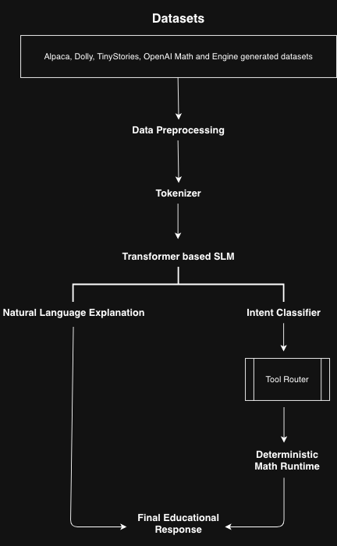

Work Flow

Slide 10

Project Plan: Phases 1 & 2
Phase 1: Core C++ AI Foundation
Develop tensor computation library, automatic differentiation engine, neural network framework, and custom tokenizer independently in modern C++.
Phase 2: Transformer Engine & Pretraining
Implement transformer architecture, optimizer, training/inference engines, pretraining on conversational corpora, and instruction fine-tuning.

Slide 11

Project Plan: Phases 3 & 4
Phase 3: Math Engine & Procedural Data
Build deterministic mathematical runtime and symbolic engine for exact computations, generating custom domain-specific datasets.
Phase 4: Integration & Evaluation
Implement routing mechanism to delegate math queries to runtime, combine outputs with language model explanations, and benchmark system accuracy.

Slide 12

Project Team Members
S.No | Student ID | Student Name | Project Role
1 | 2420030176 | Rochan | Team Member
2 | 2420090100 | Ansh | Team Member
3 | 2420090049 | Aryan | Team Member

